Slide 1
Applications of Nuclear Physics to Nuclear Security and other Societal Problems
Yale University, 18th June 2018

Slide 2
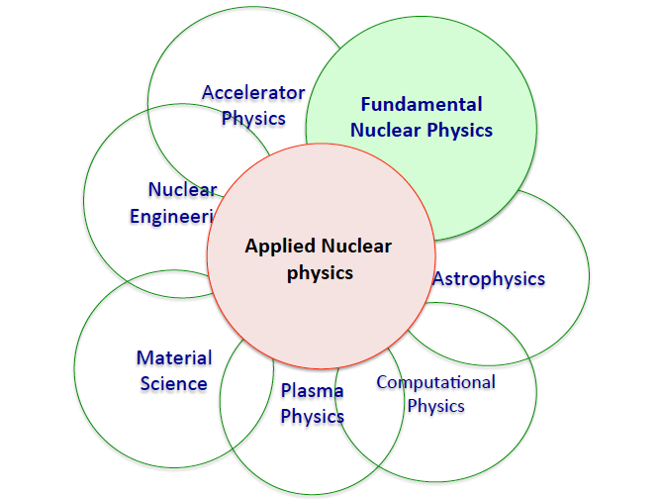
Applied Nuclear Physics is very Interdisciplinary
Medical
Physics
Generally, the applied community interact with a broad set of subfields, on very challenging problems. It’s not something one is ‘trained’ in.

Slide 3
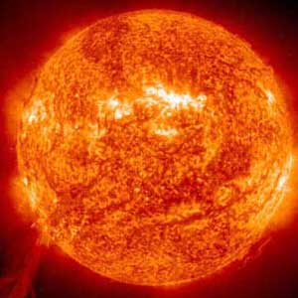
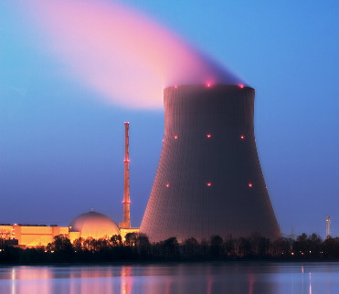
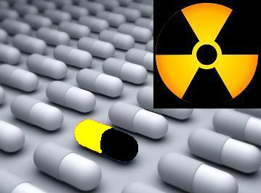
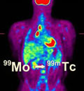
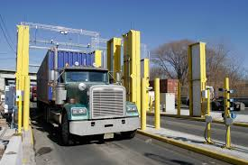
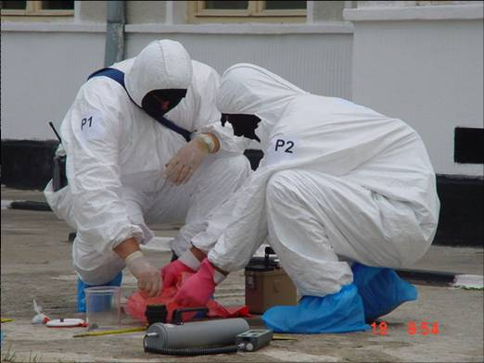
Unique Properties of Nuclei Allow Nuclear Physics Teachiques to
Address Many “Societal Needs”
Energy
  Fusion Research (NIF, ITER, …)
  Fission (Reactors)
Medicine
  Medical radio-pharmaceuticals
  Medical Imaging
  Radiation therapy
Nuclear Security
  Nuclear Forensics
  Non-proliferation & Border defense
  Stockpile maintinence without testing
A. Hayes, Applications of NP, Rep. Prog. Phys. 80 (2017) 026301
NP Decadal Study: Exploring the Heart of Matter (2013)

Slide 4
From the Earliest Days, Nuclear Physicists Applied their Knowledge to Societal Problem
Fermi and Szilard designed a successful and safe nuclear reactor, made of enriched ²³⁵U pseudo-spheres, embedded in a graphite moderator.
The design required the derivation of the necessary detailed neutron transport
and moderation.
Modern reactor designs are all based on the same basic nuclear physics principles.
E. Fermi and L. Szilard , 1955 Neutronic Reactor, US Patent 2,708,656, filed 1944.

Slide 5
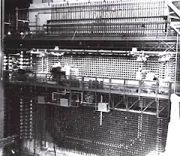
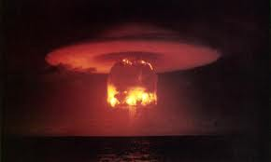
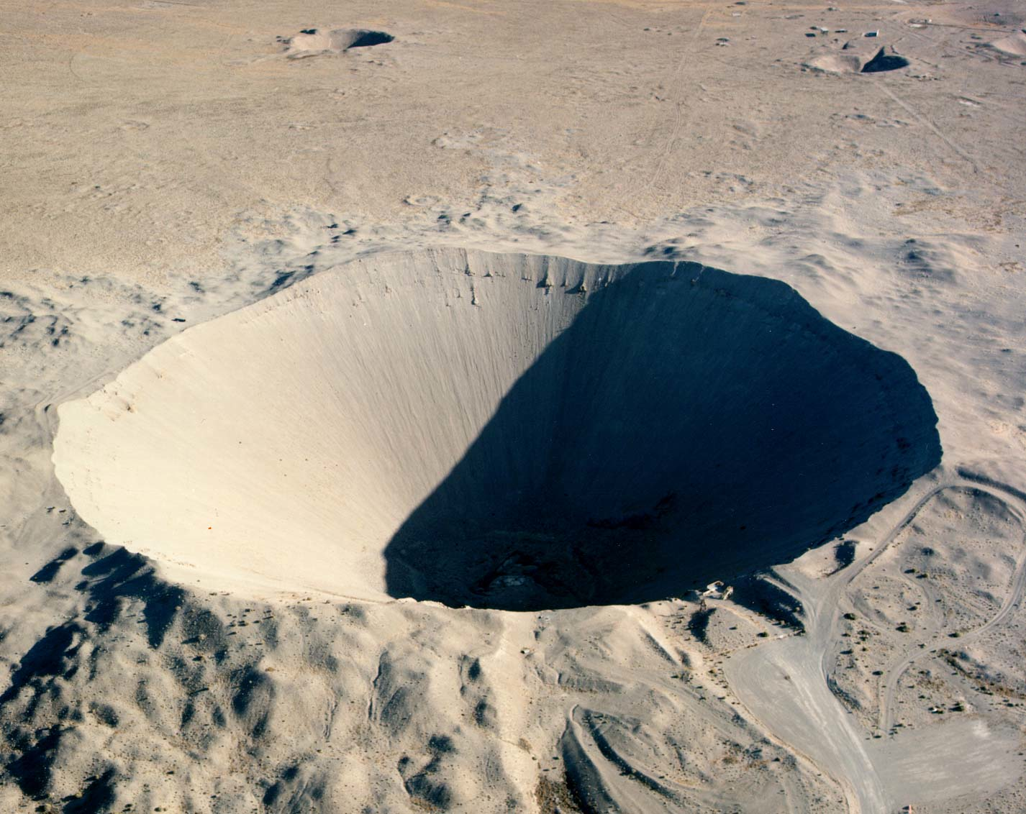

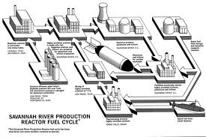
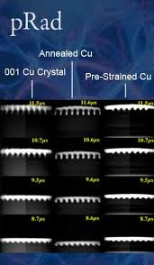
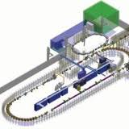
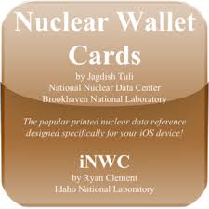
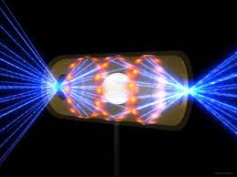
Since the Manhattan Project, Nuclear Applications have had a Large Defense & Security Component
Reactors designed for
Pu production
New weapon designs tested
Integral nuclear data
Detection of Pu activities
Stockpile Stewardship
Detailed nuclear data
for applications
NIF

Slide 6
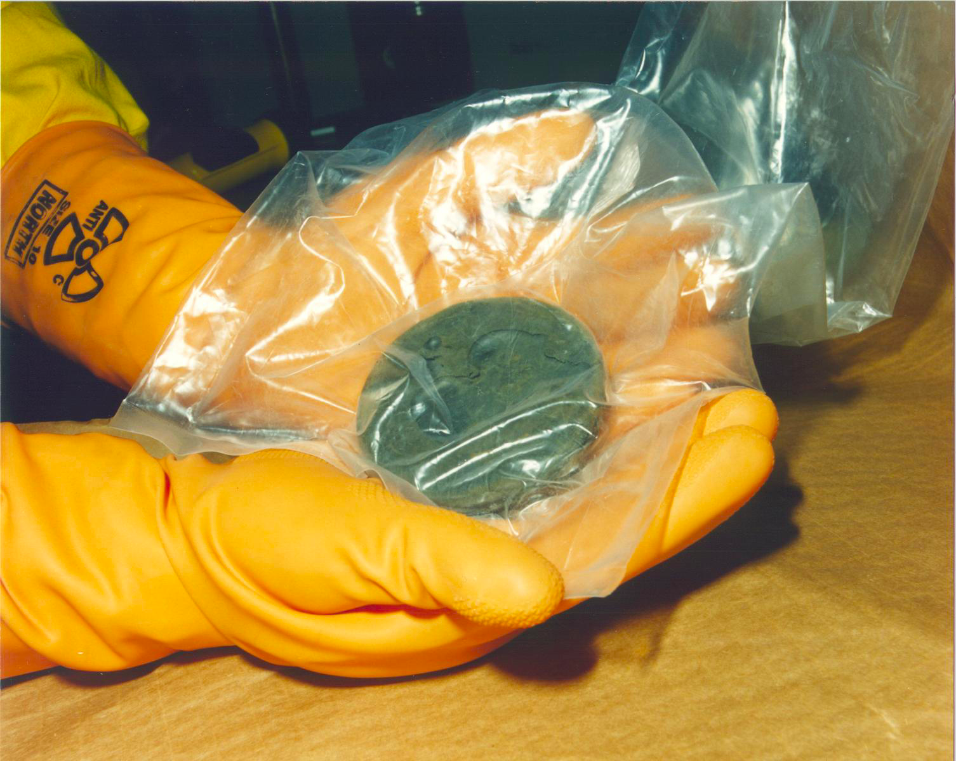
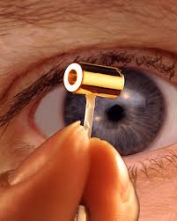
The Defense/Security Field is Driven by the Problems
Stockpile Stewardship physics
  Certification in the absence of testing: studies of archival data,
  weapons outputs, materials under extremes.
Non-proliferation
  Nuclear forensics, Detecting weapons
  production activities, Boarder protection.
Nuclear fusion
  Ignition, the interplay between nuclear
  dynamics and hydrodynamics.

Slide 7
Proton Radiography was one of the First New Scientific Developments for Stockpile Stewardship. It takes dynamic images (movies) of objects under weapons relevant conditions.
6mm Cu 12mm Cu 6mm Sn 12mm Sn
The long mean free path of high-energy protons and the ability to focus them allows movies to be taken of the behavior of material under shocked compression.
Time
800 MeV proton Prad facility at LANSCE
Example: Spall-type material failure, induced by shock waves. Observe different behavior, depending on the material and its thicknesses.

Slide 8
For example, A-2/A-1 ratios involve a neutron energy threshold, and are used to determine thermonuclear fusion yields.
Weapons Radiochemistry – a specialized form of nucleosynthesis.
Many modern nuclear cross section measurements contribute.
Differences in the energy dependence of nuclear cross sections allows inferences to be made about the exploded device from analyses of the radioactive debris.
A-2
N-2,Z
A-1
N-1,Z
A
N,Z
A+1
N+1,Z
(n,2n) (n,2n) (n,2n)
(n,γ) (n,γ) (n,γ)
A-2/A-1 = ½ σ φ
A-1(n,2n)A-2 14 MeV neutron fluence,

Slide 9
Nuclear forensics needs to provide answers on a very short timescale in the event of a nuclear attack
The transmutation of actinides in a nuclear explosion can provide detailed information on the nature of the explosion.
By deducing the neutron fluence seen by each actinide, the devise design can be reconstructed approximately.
Forensic Exercises that test the scheme are constantly being run, and the different national labs ‘compete’ with each other.
But it takes time to gather the debris and chemically separate the actinides for mass spectroscopy analysis.

Slide 10
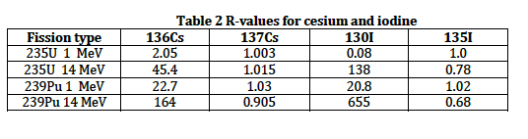
A complementary faster scheme involves blocked fission fragments in the debris.
Blocked fission fragments are very sensitive to what was fissioning, ²³⁵U, ²³⁹Pu, …
R-values are just fission fragment yield expressed as a ratios to ⁹⁹Mo – used to get rid of systematic errors.
Volatile fission fragments could be collected rapidly by flying to the plume.

Slide 11
#1 Nuclear Forensic Question: Do they have another one?
On a short timescale need to know:
Was it a uranium or plutonium device?
Was it a Boosted thermonuclear device, i.e., were there 14 MeV fusion neutrons involved?
  => Would suggest State aided.
From a measure of the R-value of ¹³⁶Cs, the key first order questions could be answered on a 1-2 day time scale.

Slide 12
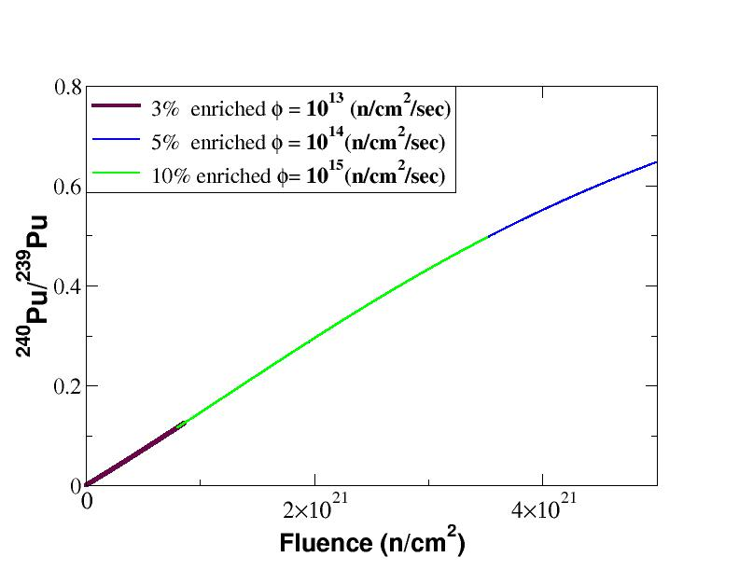
Remote Monitoring of Fuel Reprocessing Activities and the Illicit Production of Plutonium
- Possible by Detecting the Fission Gases released
A number of fission products (Xe, Kr, Cs, Ru, I ..) are released into the atmosphere during fuel reprocessing.
These products are indicators of reactor operations/design, and of the isotopics of the fuel being reprocessed
Even for very high neutron fluxes, the irradiation time needed for weapons Pu production is >100 hours.
The ratio of the unstable gaseous fission isotopes depends on the total time involved in the fuel irradiation.
Weapons Pu has a ²⁴⁰Pu/²³⁹Pu ratio of ~ 0.06

Slide 13
Example: Detection of Illicit Pu Production at a
Medical Isotope Facility
RadioXenon isotope ratios emitted from a reprocessing facility are significantly altered for any Pu production scenario.
Simultaneous reprocessing of medical isotopes and weapons fuel would be clearly detectable.
T_{irrad} Medical Isotopes(4x10⁴ n/cm²/sec) < 100 hours
T_{irrad} Weapons fuel if exposed to the full flux (4x10¹⁴ n/cm²/sec) = 350 hours
T_{irrad} weapons fuel if in blanket (~2x10¹⁴ n/cm2/sec) = 700 hours

Slide 14
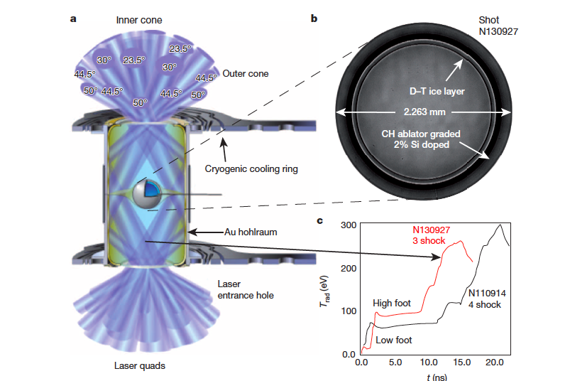
The National Ignition Facility aims to achieve Fusion Ignition through indirect drive of inertial confinement capsules.
Many Stockpile Issues are also addressed at NIF.
A capsule of DT gas, surrounded by a layer of DT ice and a CH ablator, is placed inside a Au hohlraum
192 laser beams create an x-ray bath inside the hohlraum
The laser pulse shape depends on the design, with highest current yields from ‘High Foot’ pulses
The x-rays ablate off the outer layer of the capsule
The capsule implodes and the central DT gas burns

Slide 15
The Burn Rate is determined by the velocity-averaged cross-section and the ion densities
The pp chain in the Sun is not practical because the first reaction involves the weak interact and is very slow:
The Coulomb barrier dedicates that reactions involving D or T are the only practical fuels
By far the largest reaction rate is:
D+T → n + α

Slide 16
The Capsule Involves Three Layers: DT Gas, DT Ice, and a Plastic Ablator
The burn takes place in the inner DT gas layer.
If ignition were achieved, the burn would propagate into the DT ice, and the yield would increase 100 fold.
But to-date the DT ice layer remains cold (~0.2 keV).
The cold DT fuel is also quite dense (~5x10²⁵ cm⁻³).
This results in a quantum degenerate DT ice layer that allows studies of unique plasmas conditions.

Slide 17
Rare Nuclear Reactions in the Cold Fuel are produced by the neutrons from the hotspot knocking-on D and T ions to MeV Energies.
These reactions are also used as Stockpile Diagnostics.
n
D
T
n
dE/dX
RIF E_{n} = 9.2-30 MeV
D
12C (or Br)
¹²C(d,n)¹³N (or Br(d,2n)Kr)
If the knock-on (KO) ion undergoes a DT reaction, it produces a Reaction-in-Flight neutron (RIF).
If the KO ion undergoes a nuclear reaction with other material , it produces a RADCHEM reaction.
Both reaction types were measured in weapons shots and NIF tests key Stockpile diagnostic concepts.
The KO fluence is determined dE/dX in a quantum degenerate plasma – new studies of degeneracy in plasmas.

Slide 18
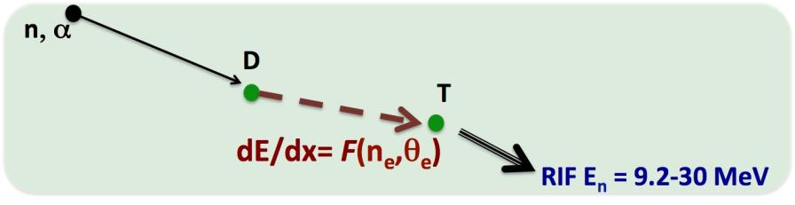
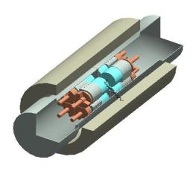
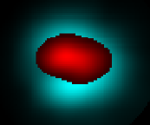
Clover Detector, Originally a Prototype for Majorana 0νββ, allowed 1st Measurement of Rare Reaction-in-Flight Neutrons at NIF
RIF neutrons are fusion products from KO in-flight fuel ions.
They provide a key diagnostic
of the plasma ρ, θ and dE/dx.
RIFs= 10⁻⁴-10⁻⁵ of the n-spectrum
4π clover detector measured the ¹⁶⁹Tm(n,3n)¹⁶⁷Tm, E_{th} = 15 MeV, and
²⁰⁹Bi(n,4n)²⁰⁶Bi, E_{th} = 22.5 MeV
Prototype detector of Majorana ββ-decay
Analysis of the RIF neutrons showed that the cold fuel is a quantum degenerate plasma. This allowed the 1st measurements of stopping powers in degenerate plasmas.
Burning fuel
n
DT Ice layer
KO

Slide 19
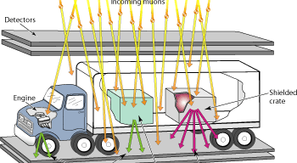
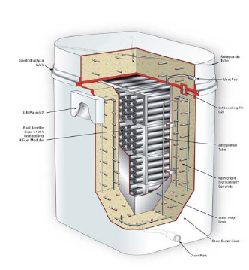
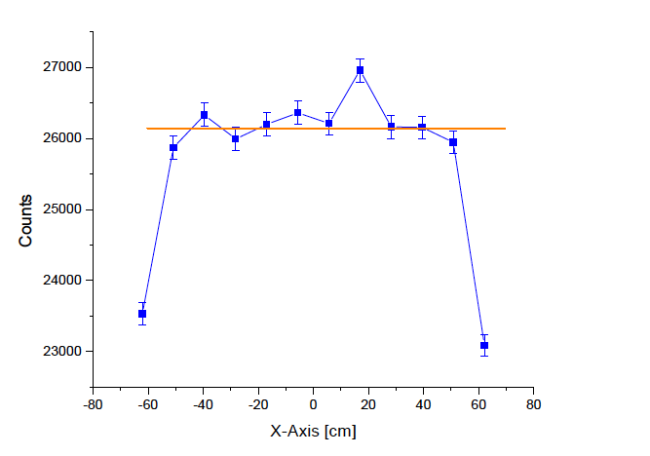
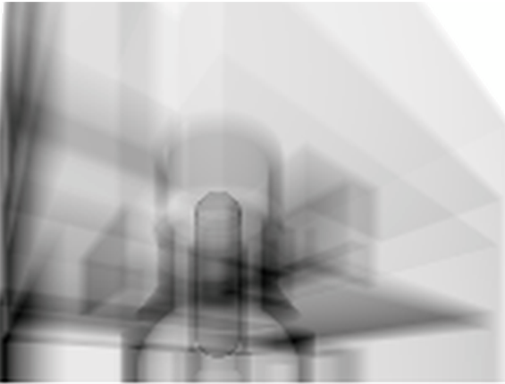
Muon Imaging, extended to 3-D Tomography, is addressing several of Today’s societal problems
Coulomb scattering of muons from a target is approx
Spread of scattering angles discriminates
between low and high Z material– very short time scale required
Sensitivity to material in spent fuel in dry storage containers exceeds the IAEA requirements for material accountancy
– time scales ~10 days (AECL, Canada)
Missing fuel
in one column easily detectable
Muon radiography images suggest a complete core melt at reactor #1 at the Fukushima Daiichi reactors.
Confirms beliefs that the highly radioactive slag is now at the bottom of the pressure containment vessel

Slide 20
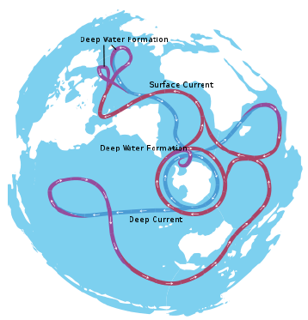
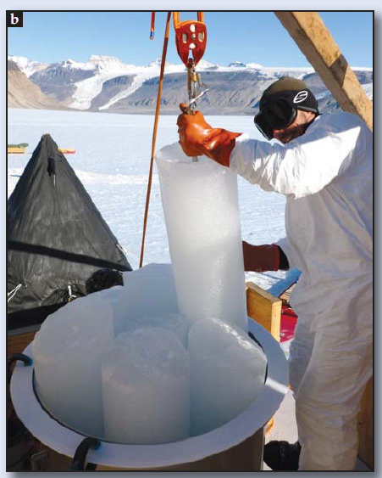
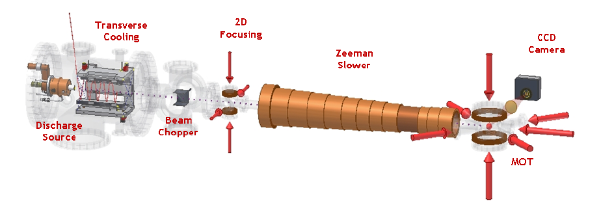
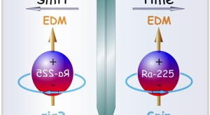
Atom Trap Trace Analysis, using similar techniques as in Nuclear EDMs searches, are addressing problems in earth and climate science
The half-life, inertness, and low water solubility of ³⁹Ar and ⁸¹Kr makes them very good probes of many Earth Science problems
But 1 liter water => 4x10⁻⁷ decays of ⁸¹Kr per hour
Measuring trace noble gases for:
Assessing groundwater availability
Groundwater recharge rates
Atmospheric history from ice cores
Oceanic circulation
Geothermal processes
Many of these application are made possible by ATTA, which requires extremely small samples, and measure Ar and Kr isotopes to 1:10¹⁶
Z-T Lu, Physics Today March 2013

Slide 21
Nuclear Physics has Transformed both
Diagnostic and Therapeutic Medicine
Nuclear imaging is extremely powerful compared to traditional techniques, e.g., x-ray, CScan, MRI.
PET (Positron emission tomography) can can produce a 3-D reconstructed image of the organ under investigation.
Toxic level of radiation can be delivered directly to the site of interest by attaching radionuclides to a molecular carrier that binds to the site or tumor.

Slide 22
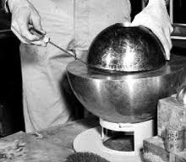
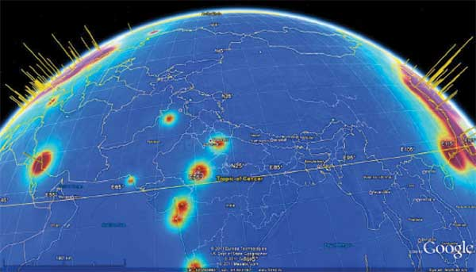
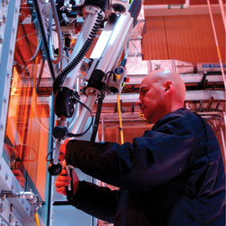
Many other Applications
Neutron-Diagnosed Subcritical Experiments (NDSEs). will reach unprecedented precision in Nuclear Criticality Experiments
  made possible by the gamma-ray detection
  developments from the n+p→d+γ PNC experiments
Watchman
Water Cherenkov neutrino detector to monitor reactors
Enhanced detectors for nuclear non-proliferation
  Many detector designs developed for fundamental nuclear physics are being studied for detection of low levels special nuclear material.
  New research aimed at verifying plutonium deposition treaties.
Strong collaborations with the Isotope Program
  E.g., ¹⁶⁹Ho, ²²⁵Ra

