Slide 1
Experimental Neutrino Physics I:
Working with Neutrinos
Diana Parno
Carnegie Mellon University
National Nuclear Physics Summer School, New Haven, CT
22 June 2018

Slide 2
Lecture Plan
Lecture 1: Working with Neutrinos
  Sources
  Detectors
  Oscillations
Lecture 2: The Nature of Neutrinos
  Neutrino-mass scale
  Searching for Majorana neutrinos
Lecture 3: Neutrinos as Tools
  Neutrinos for astrophysics
  Neutrinos for geology
  Neutrinos for nuclear physics
  Neutrinos vs the Standard Model

Slide 3
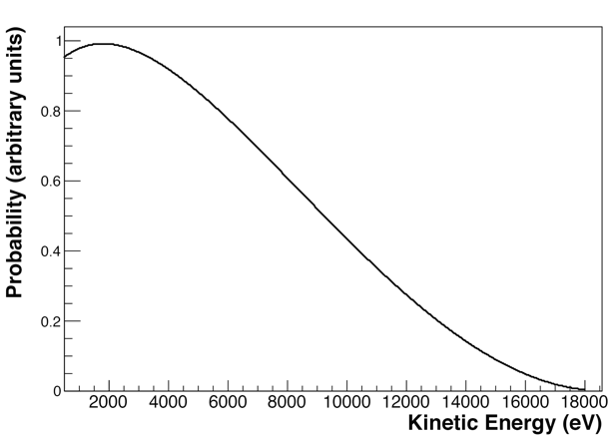
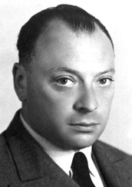
The Neutrino: A “Desperate Remedy”
1930: Proposed by Pauli to explain beta spectrum
ν_{e}
Beta spectrum for T decay
e⁻
³H
³He
Additional, unseen particle needed to save energy conservation
I have done a terrible thing. I have postulated a particle that cannot be detected.

Slide 4
Neutrinos for Poets
Leptons
Neutral
Neutrinos, they are very small.
They have no charge and have no mass
And do not interact at all.
The earth is just a silly ball
To them, through which they simply pass...
-- John Updike, “Cosmic Gall” (1960)
Now we know better
Weak interactions
Correct

Slide 5
Outline
Neutrino sources
  Fission reactors
  The Sun
  Accelerators
  The atmosphere
  Outside the solar system
Neutrino detectors
Neutrino oscillations

Slide 6
What Kind of Neutrino?
Two different neutrino bases: flavor and mass
  Each flavor state is associated with a charged lepton (e, μ, τ) in charged-current interactions
  Each mass state is a superposition of flavor states
We’ll consider neutrino sources based on flavor and energy

Slide 7
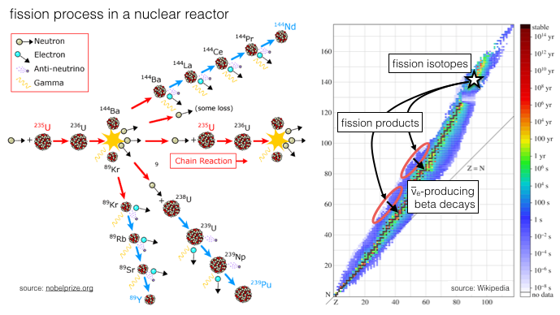
Neutrinos from Nuclear Reactors
Fission reactors produce electron antineutrinos at a few MeV

Slide 8
Neutrinos from the Sun
At its core, the Sun is a fusion reactor ...
These are all created as electron neutrinos!
pp
pep
⁷Be
⁸B
Flux (cm⁻² s⁻¹)
Graphic: Oleg Smirnov
0.1
1
10
³He + p → ⁴He + e⁺ + ν_{e} at 0.3 ppm
Neutrino energy (MeV)

Slide 9
Neutrinos from Accelerators
Graphic: Kate Scholberg

Slide 10
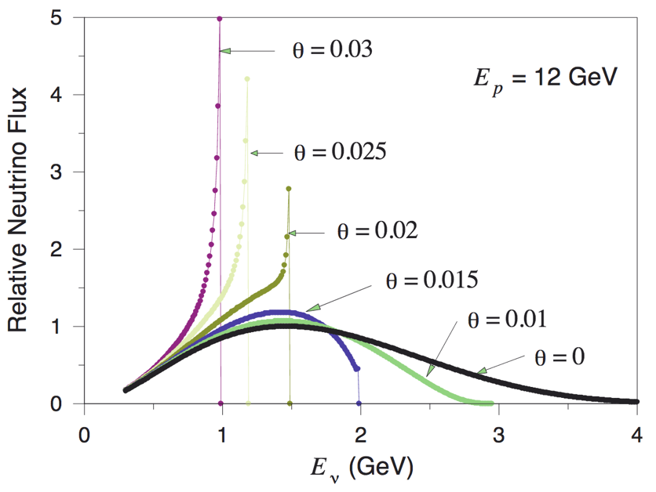
Neutrinos from Accelerators
Neutrinos are emitted from meson beam with a continuous distribution of energy and angle
An off-axis detector sees a neutrino beam with a tighter energy spread
Plot: McDonald, arXiv: 0111033 [hep-ex]
Preprint includes detailed derivation!
Increasing angle

Slide 11
Neutrinos from the Atmosphere
Cosmic rays interact in upper atmosphere, making muons
Muons decay, producing neutrinos
Use angular distribution to probe different path lengths
David Fierstein for Scientific American, August 1999

Slide 12
Neutrinos from Beyond ...
Multi-messenger astronomy era – combination of data from photons, neutrinos, and gravitational waves – is beginning
Slide from Ignacio Taboada

Slide 13
Neutrino Energy Scales
From Nature...
... and from scientists
Graphics: Kate Scholberg

Slide 14
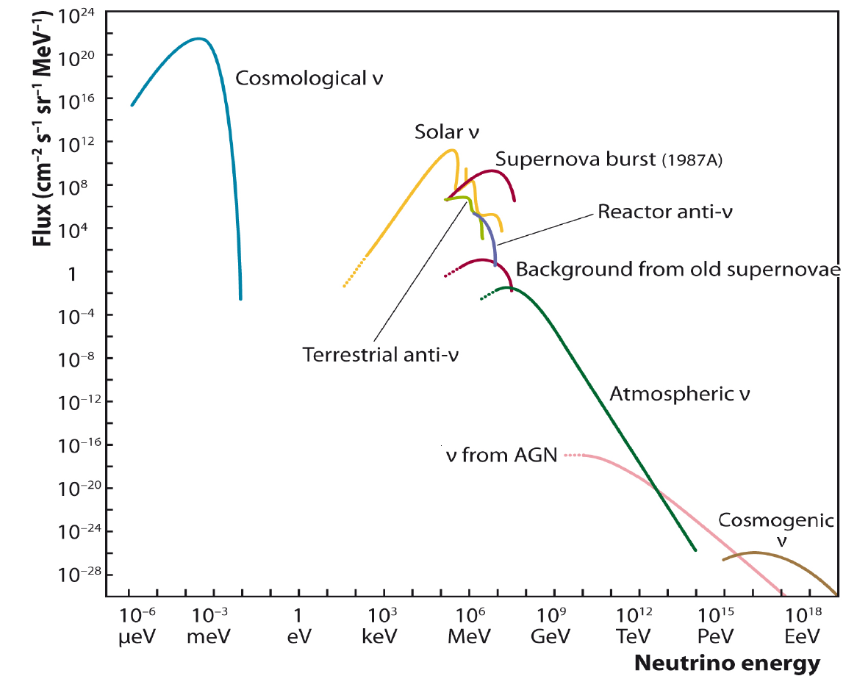
Neutrino Energy Scales
Let’s make that picture a little more quantitative ...
Katz, Prog. Part. Nucl. Phys. 67 (2012) 651

Slide 15
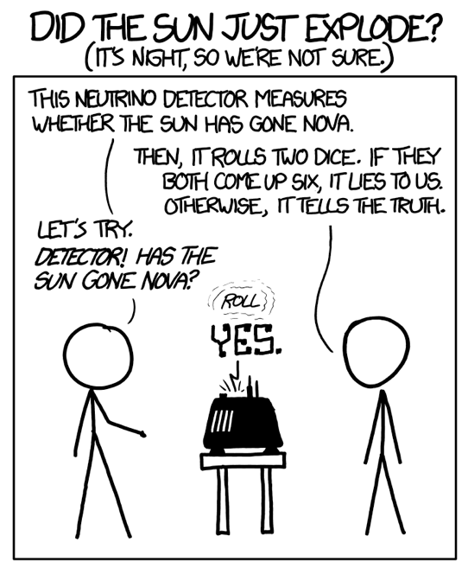
Outline
Neutrino sources
Neutrino detectors
  Charged-current interactions
  Neutral-current interactions
  A few detector technologies
Neutrino oscillations
https://xkcd.com/1132/

Slide 16
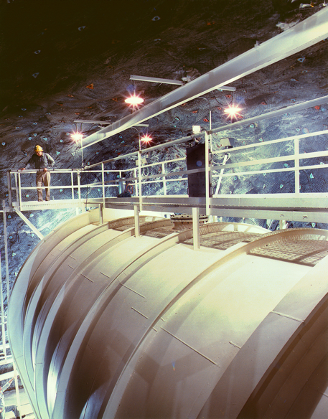
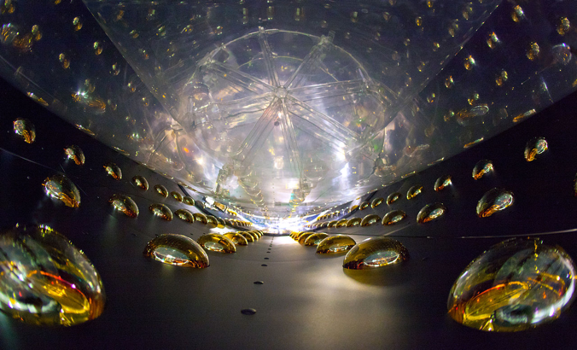
Neutrino Detection I
Charged-current interactions
  W± boson exchange
  Initial neutrino final charged lepton
Example: inverse beta decay
e⁺
n
W⁺
v_{e}
p
v_{e} + ³⁷Cl ³⁷Ar + e⁻
v_{e} + p n + e⁺
Homestake
experiment
(Ray Davis)
1970-1994
Daya Bay Experiment
2011 - Present

Slide 17
Detecting Inverse Beta Decay
Graphic: J. Pedro Ochoa-Ricoux
Prompt (= essentially no delay) observation of positron
  Positron energy → incident antineutrino energy
Delayed signal from neutron capture on Gd dopant
Coincidence signal allows efficient background rejection

Slide 18
CC Detection Thresholds
Charged-current interactions have flavor-dependent thresholds – you need enough energy to create the charged lepton!
Graphic: Janet Conrad

Slide 19
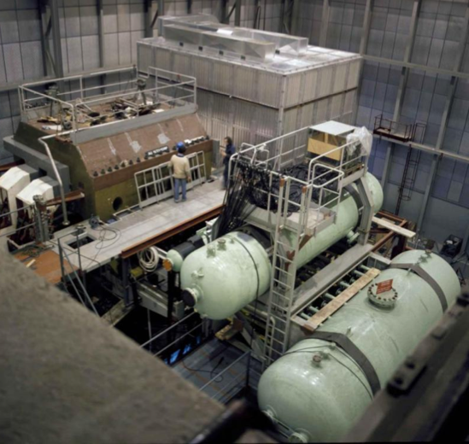
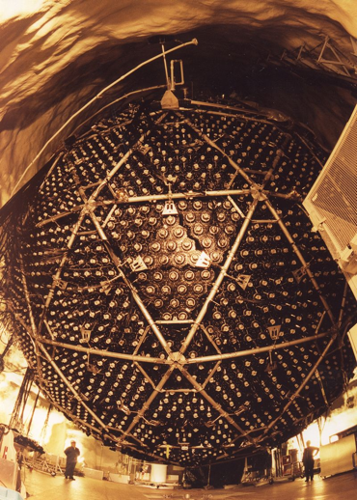
Neutrino Detection II
Example: deuterium dissociation
Neutral-current interactions
  Z boson exchange
  Neutrino survives
ν_{X}
ν_{X}
p
²H
n
v_{μ} /v_{μ} + e⁻ v_{μ} /v_{μ} + e⁻
v_{μ} /v_{μ} + N v_{μ} /v_{μ} + hadrons
v_{e} + d v_{e} + n + p
Sudbury Neutrino Observatory (SNO)
1999-2006
Gargamelle
1970-1979

Slide 20
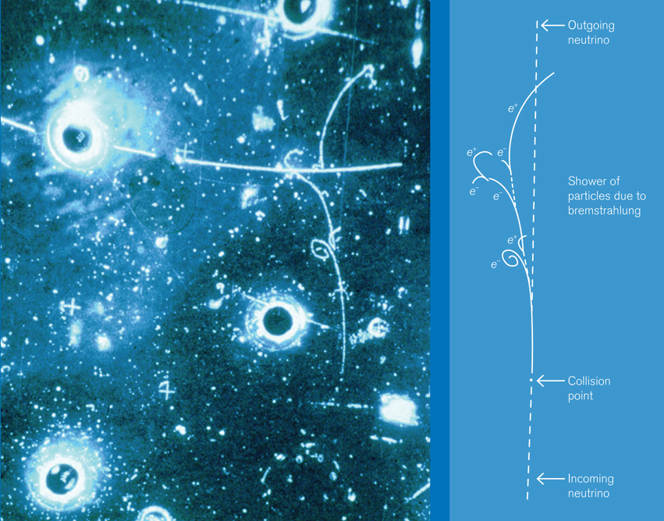
NC Event from Gargamelle
Image from CERN
Printed in Symmetry,
August 2009

Slide 21
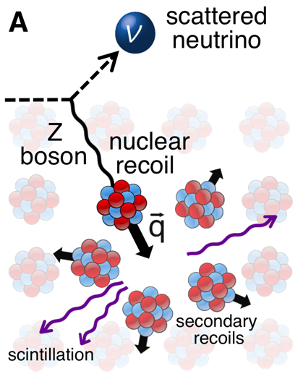
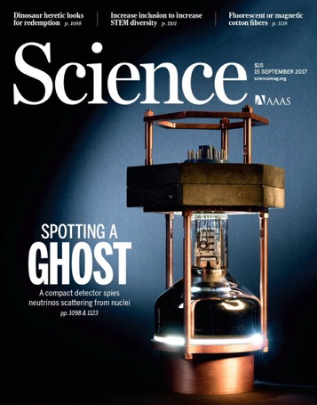
Coherent Elastic ν-N Scattering
Enhanced cross section from coherent interaction with entire nucleus
But – need E_{ν} < 50 MeV. Only signal is tiny nuclear recoil!
ν
A
COHERENT collaboration: First discovery, 2017!
Z
ν
A
CsI[Na] detector
Pulsed neutrino beam from Spallation Neutron Source
Akimov et al., Science 357, 1123 (2017)

Slide 22
Cerenkov Detectors
If a charged particle in a medium has β > 1/n, it will emit Cerenkov radiation
# photons proportional to energy loss
Cone gives directionality of incoming neutrino
Now you just need enough phototube coverage to make a good measurement!
Graphics: Kate Scholberg

Slide 23
Particle ID with Cerenkov Light
To measure in flavor basis, must distinguish muons from electrons
Symmetry broken by interactions in medium
  Muons (at these energies) are minimum-ionizing particles
  Electrons produce showers
  Light from showers blurs the conical surface
Sharp ring:
Muon!
Fuzzy ring:
Electron!
Graphics: SuperK

Slide 24
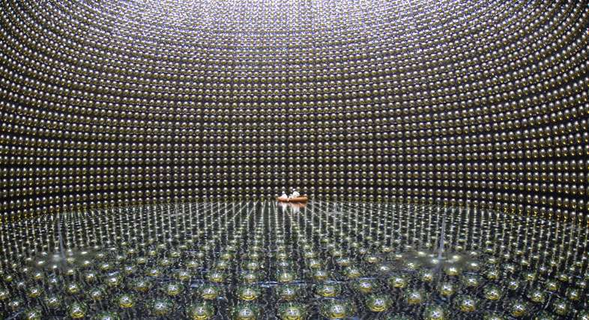
Build-Your-Own Tank
Super-Kamiokande: 32 kton ultrapure water; 11146 inner PMTs; 1 km underground

Slide 25
Neutrino Telescopes – Natural Tanks
Instrument Antarctic ice?
Or the Mediterranean?
IceCube
ANTARES

Slide 26
Outline
Neutrino sources
Neutrino detectors
Neutrino oscillations
  A very brief history of oscillation experiments
  Snapshot of oscillation results
  Goals for the next decade(s)

Slide 27
Design an Oscillation Experiment
Disappearance:
  Start with a known flavor.
  Let it propagate.
  Is it still there?
Not enough energy for charged-current interactions with new flavor
Appearance:
  Start with a known flavor.
  Let it propagate.
  Do you see a new flavor?
Must clearly distinguish between reactions with multiple flavors

Slide 28
The First Clue: Homestake
Davis executed experiment
Bahcall developed theory
Slide: Dan Dwyer

Slide 29
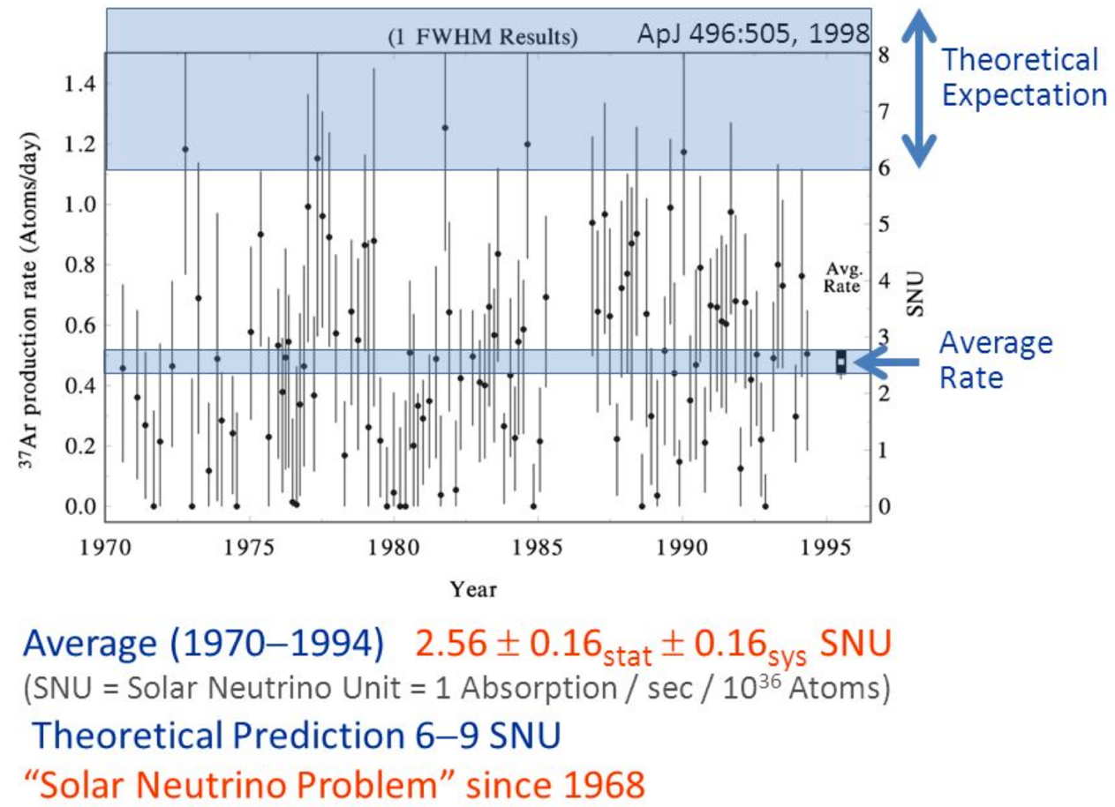
The First Clue: Homestake
Slide: Georg Raffelt

Slide 30
Clear Signature: Super-K
Measure “up/down” asymmetry in atmospheric nm
Up-going neutrinos pass through Earth – longer path length for oscillation
Takaaki Kajita, Nobel Prize Lecture, 2015
<5500 events in 19 years of running – neutrino experiments catch ghosts
Up-going
Down-going
Up-going
Down-going

Slide 31
Confirmation: SNO
Sudbury Neutrino Observatory: combine CC, NC sensitivity
  Measure both ν_{e} disappearance AND total ν_{X} flux
  Confirm where missing electron neutrinos went
Solar Standard Model
All neutrinos
Electron neutrinos
Calibration
Plots from Art McDonald, Nobel Prize Lecture, 2015

Slide 32
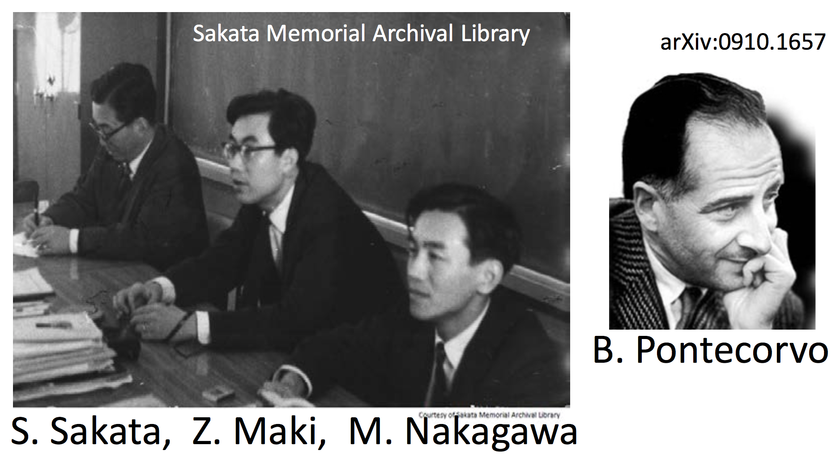
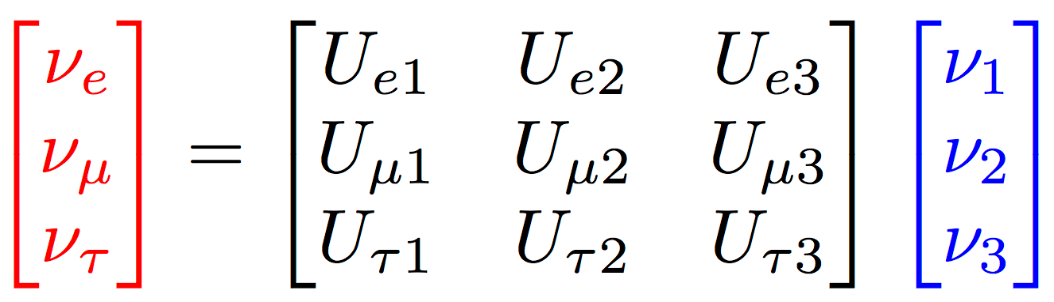
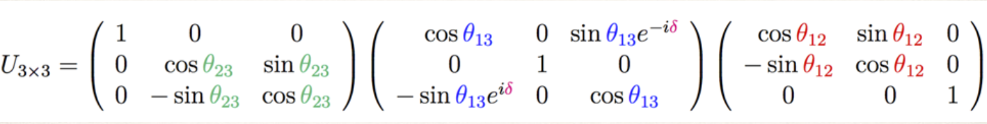
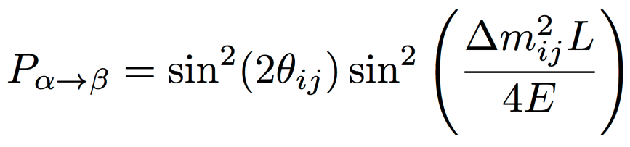
The PMNS Matrix
Governs mixing between ν flavor and mass states
Simplified 2-flavor neutrino oscillation:
More details from Michael Ramsey-Musolf on Monday

Slide 33
Picking a Baseline
Oscillation wavelength proportional to L/E_{ν}
Tune source energy – or baseline – to optimize sensitivity to selected oscillation parameters
Sample plot for reactor disappearance experiments
Plot: Christian Buck

Slide 34
Experimental Landscape
Terrestrial-source oscillation experiments cover lots of ground
Graphic: Janet Conrad

Slide 35
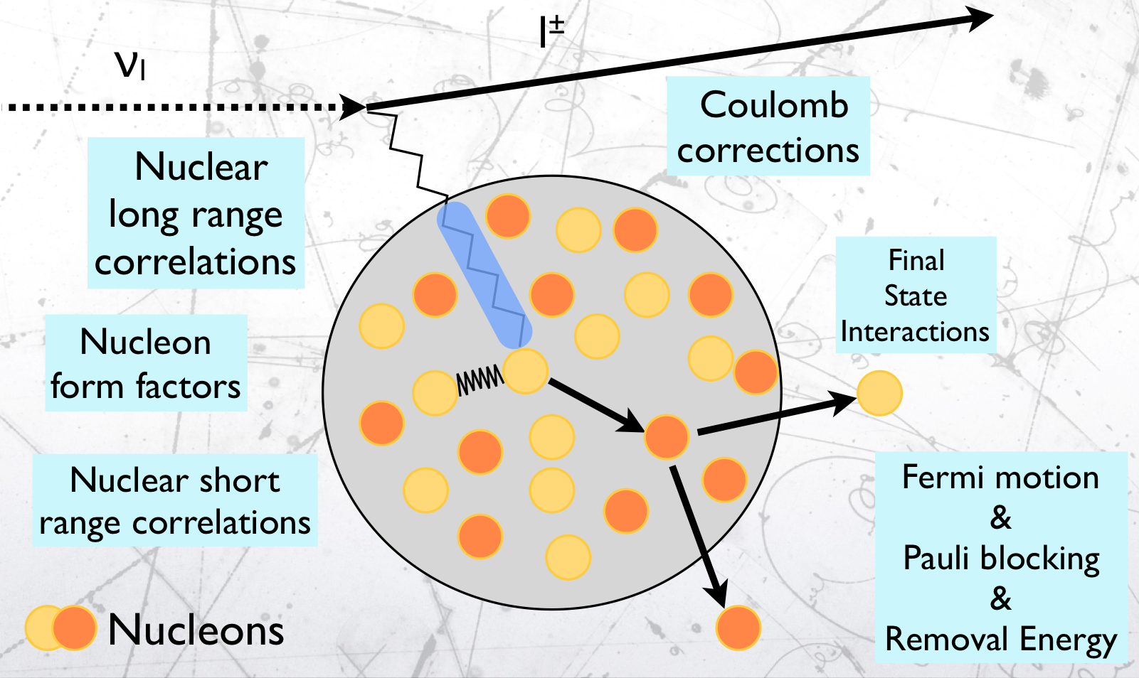
Caveat: Energy Reconstruction
“Measured” neutrino energy is reconstructed from final-state leptons and hadrons
  We don’t know the nuclear physics that well!
Dedicated nuclear cross-section measurements
Identical Near/Far detectors help cancel systematics
  Also aid in flux normalization
Graphic: Federico Sánchez

Slide 36
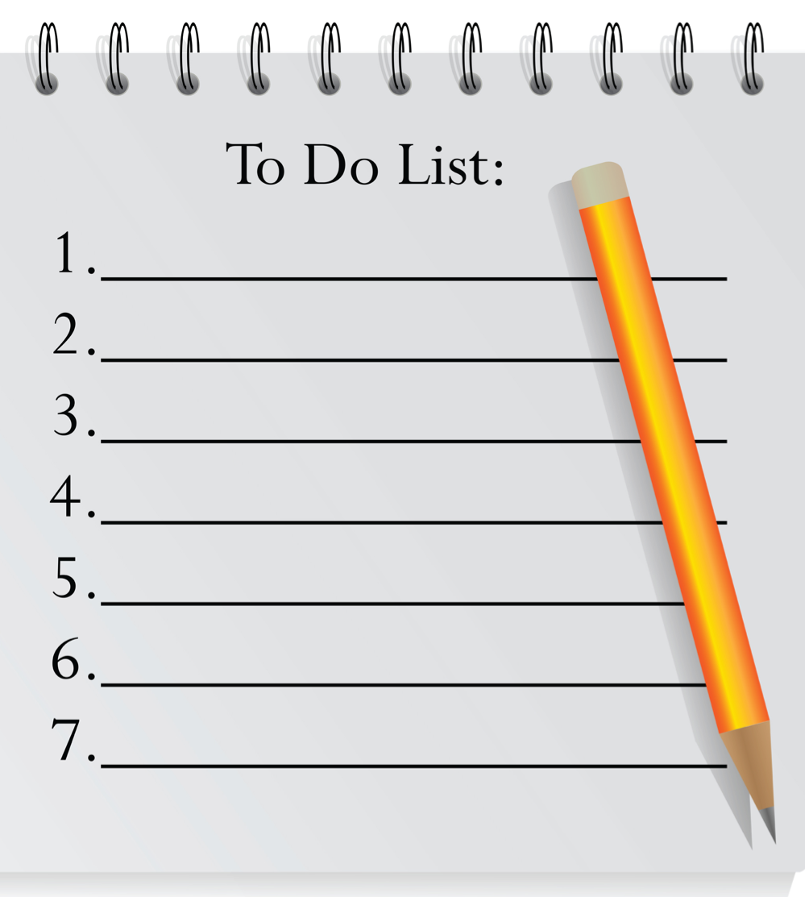

Remaining Questions
Neutrino mass ≠ 0?
Precise mixing matrix
Oscillation experiments
Mass ordering?
CP violation?
Absolute mass scale?
Next lecture
Neutrino ≠ antineutrino?
Next Friday
Sterile neutrinos?
8. Other surprises?

Slide 37
Mass Ordering and CP Violation
Is ν₃ – the mass state that couples most to ν_{τ} – the heaviest or the lightest of the neutrino masses?
Is CP symmetry – invariance under charge conjugation + mirror inversion – conserved in the neutrino sector?

Slide 38
Oscillation Parameters
Worldwide program working toward precision parameters
Fits change based on mass ordering
Is this mixing angle maximal?
Slide:
Mariam Tórtola

Slide 39
Early Hints
Several experiments favor normal ordering – but not by much
Careful joint analyses are beginning
Slide: Mariam Tórtola

Slide 40
Closing in on the Mass Ordering
Slide from Takaaki Kajita, Neutrino 2018

Slide 41
Next Generation: DUNE
40-kton LAr time-projection chamber to measure ν_{μ} disappearance and ν_{e} appearance
Start investigating mass ordering, CP violation when beam comes on in 2026
  Head start on physics with solar, atmospheric νs
(South Dakota)
(Illinois)
Near detector
Far detector

Slide 42
Next Generation: Hyper-K
186-kton water Cerenkov detector
  Also sensitive to proton decay among other physics
Beam + detector online 2026
  Non-beam studies before that
Plus (maybe) a very far detector in South Korea?

Slide 43
Next Generation: JUNO
JUNO will use reactor neutrinos (not accelerator)
  Complementary neutrino source (and detection method)
Data-taking targeted to 2021
Graphics: Björn Wonsack

Slide 44
What About Sterile Neutrinos?
Not all oscillation results are entirely consistent with the standard 3-neutrino picture
  Why don’t measured reactor fluxes match predictions?
  What is the measured bump in reactor antineutrino spectrum at 5 MeV?
  Why does MiniBooNE see too many electron neutrinos?
    arXiv:1805.12028 [hep-ex]
One possible explanation: sterile neutrinos with no weak charge, that mix with the active (e,μ,τ) flavors
Comprehensive (but slightly out of date) review at arXiv:1204.5379 [hep-ph]
Michelle Dolinski
Seminar next Friday

Slide 45
A Shameless Advertisement
My group is hiring a postdoc to work on:
  KATRIN
    Direct measurement of neutrino mass – see lecture after lunch
  COHERENT
    CEvNS measurements on multiple nuclei
Apply on Interfolio by July 17 for full consideration:
  https://apply.interfolio.com/5143

